Slide 1
DATA POWERPOINT
Template by HubSpot

Slide 2

How to Use This Template:
Thanks for downloading this resource.
Use this presentation as a guide/inspiration for your own PowerPoints. Format the presentation using your brand’s colors, fonts, images, and style.
Add new slides using the “New Slide” button in the toolbar.
These templates are for both Mac and PC users, but if anything shows up a little funky or misaligned, just adjust to the slide and shift around anything that may appear different.
Use the elements you need. If you like a text box or layout from one slide, copy & paste it onto another and mix and match designs.
Notes:
Please watch all videos above.

Slide 3

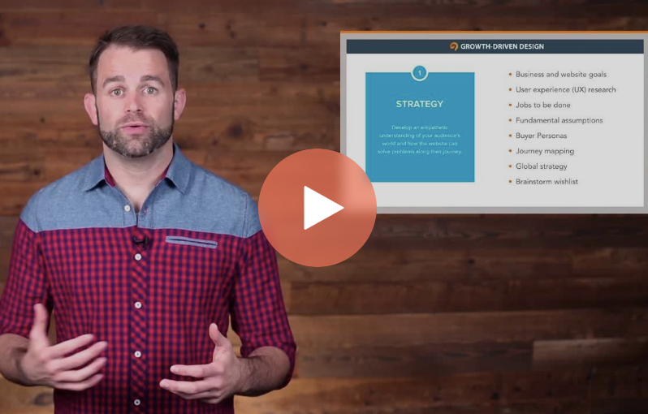
Sharpen your skills
With HubSpot Academy
Take free courses on Inbound Marketing, Sales, and Customer Service
Visit https://bit.ly/3auUHUl to Get Started Free
Notes:
Product Screenshot Full MacBook

Slide 4
Presentation Best Practices
Use this presentation as a guide/inspiration for your own PowerPoints. Format the presentation using your brand’s colors, fonts, images, and style.
Add new slides using the “New Slide” button in the toolbar.
These templates are for both Mac and PC users, but if anything shows up a little funky or misaligned, just adjust to the slide and shift around anything that may appear different.
Use the elements you need. If you like a text box or layout from one slide, copy & paste it onto another and mix and match designs.

Slide 5

Presenter: Chris Pierce
Notes:
Photo by Tamarcus Brown on Unsplash

Slide 6
Agenda
Introductions
Q1 Recap
Q2 Goals
Q3 Projections

Slide 7
Introduce a new section here.
1
What’s this section about?

Slide 8
Here’s a column chart, great for comparing values

Slide 9
100%
of people think this slide
is a great way to display
a statistic.
Source: Insert Here

Slide 10
Introduce a new section here.
2
What’s this section about?

Slide 11
Use the line graph below to compare values over time

Slide 12
100%
of people think this slide
is a great way to display
a statistic.
Source: Insert Here

Slide 13
Introduce a new section here.
3
What’s this section about?

Slide 14
This pie chart is great for displaying percentages

Slide 15
100%
of people think this slide
is a great way to display
a statistic.

Slide 16
QUESTIONS?

Slide 17

Grow your traffic, convert leads, and prove ROI with our all-in-one marketing software.
Visit bit.ly/2zfjZD4 for a free demo.

